Slide 1
STATISTICAL MACHINE LEARNING-2 PRACTICAL HOMEWORK-1 ON YOUTH DRUG ANALYSIS
By Alekhya Dabbiru
MS in DS

Slide 2
INTRODUCTION
The “Youth Drug Analysis” project investigates the factors that are correlated with drug use by using decision trees and ensemble methods.
The youth_data file is a pre-cleaned subset of the NSDUH 2023 dataset.
Contains responses from approximately 2,900 youth under 18 across 79 selected variables.
It includes demographics, youth experiences, and use of various drugs, with full descriptions available in the NSDUH codebook.

Slide 3
MODELLING OVERVIEW
In the coding part, we’ve covered all the three required models using R programming in RStudio:
BINARY CLASSIFICTION- Can we predict whether a youth has ever consumed alcohol?
MULTI-CLASS CLASSIFICTION– How frequently has a youth used marijuana over the past year?
REGRESSION - How many days did a youth consume alcohol in the past month?

Slide 4
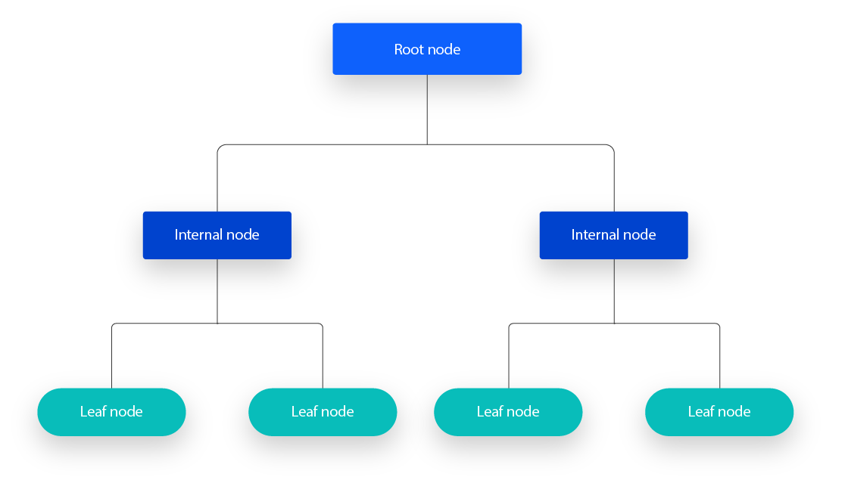
Theoretical background
DECISION TREE:
A supervised learning algorithm, used in both classification and regression tasks to make prediction.
Organizes data into a hierarchical tree structure with root nodes, branches, and leaf nodes.
At each branch, it asks a simple yes/no question about the data and follows that path.

Slide 5
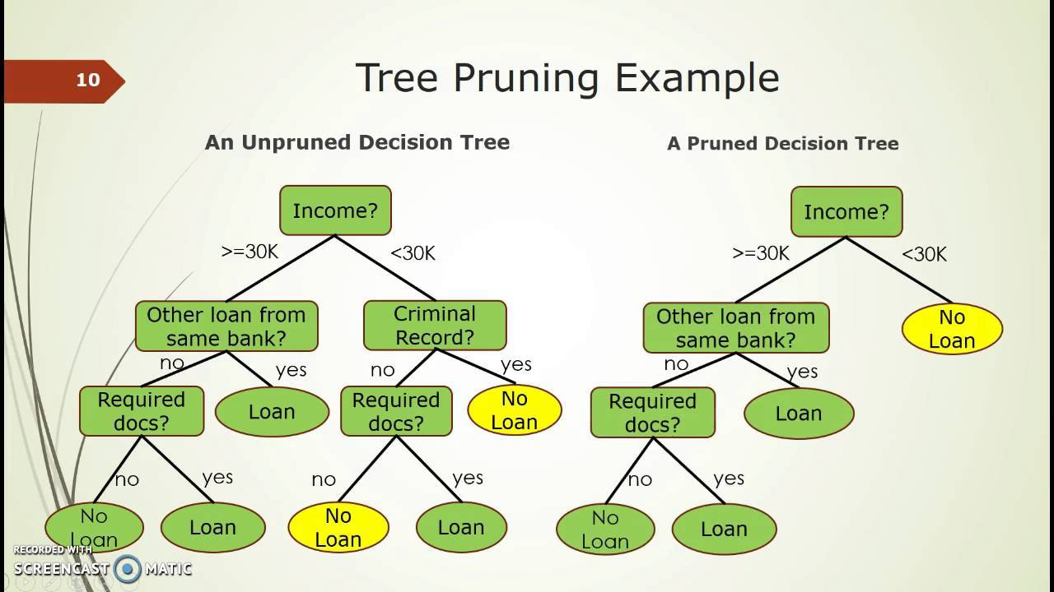
PRUNING:
Pruning removes parts of the tree that don’t help improve predictions.
It keeps the tree from getting too complex and overfitting the data.
In R code, we have used cross-validation approach to find the optimal size of the tree.

Slide 6
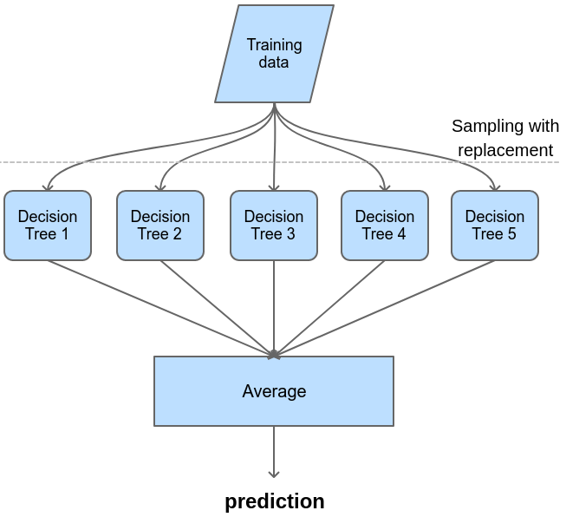
THEORTICAL BACKGROUND: ENSEMBLE METHODS
BAGGING: Bagging builds multiple decision trees on randomly sampled subsets of the training data, with replacement.
This method reduces variance and improves model stability.
For classification, final predictions are made based on majority vote.
For regression, predictions are averaged.

Slide 7
THEORTICAL BACKGROUND: ENSEMBLE METHODS
RANDOM FOREST:
Random Forest extends bagging by selecting a random subset of predictors at each split.
This reduces correlation among trees and improves overall performance.
The number of predictors evaluated at each split (mtry) is the key tuning parameter.
This approach excels with high-dimensional data and naturally guards against overfitting.

Slide 8
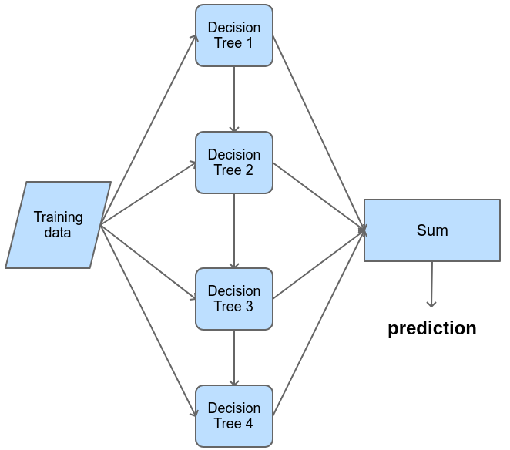
THEORTICAL BACKGROUND: ENSEMBLE METHODS
BOOSTING: Models are trained one after another, with each new model focusing on the mistakes of the previous one.
• Later models pay extra attention to observations that were misclassified or poorly predicted.
• The final prediction is formed by weighting each model’s vote in classification or averaging their outputs in regression.

Slide 9
DATA CLEANING
Referred to the NSDUH Codebook for variable definitions, codes, and valid ranges.
Cleaned data further during modeling to improve quality.
Kept special codes (991, 993, 994, 997, 998) for “unknown” or “refused” instead of removing them.
Recoded categories with clear, descriptive labels to make charts and model results easy to read .
Removed any rows that still had missing values after all cleaning steps.
Filled special numeric codes by replacing them with the mean of valid responses.

Slide 10
METHODOLOGY
BINARY CLASSIFICATION: We predicted whether a youth had ever consumed alcohol.
• Decision tree trained on key factors and pruned to three splits via cross-validation to reduce misclassification error.
• Ensemble models were tuned for peak performance:
bagging used all predictors with 500 trees;
random forest used five predictors at each split (mtry = 5) with 500 trees;
boosting used 1,000 trees, shrinkage of 0.01, and depth of three.

Slide 11
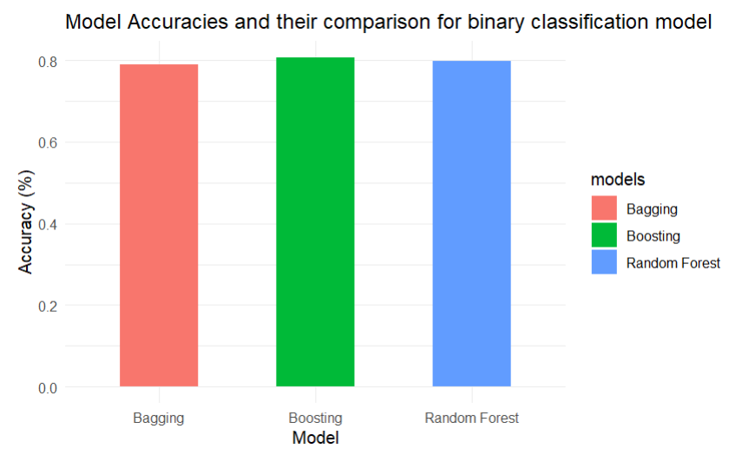
BINARY CLASSIFICATION MODEL EVALUATION
Friends who drink daily or use marijuana monthly were the strongest predictors.
Ensemble accuracies were 80.7% for boosting, 79.9% for random forest, and 79.1% for bagging, with random forest also achieving 94.4% sensitivity, 36.5% specificity, and 65.5% balanced accuracy.

Slide 12
METHODOLOGY
MULTI-CLASS CLASSIFICATION: Predicted marijuana use frequency over the past year, grouped into six categories.
Trained and pruned a decision tree to three splits via cross-validation to prevent overfitting.
Key predictors: peer marijuana use, peer smoking behavior, and whether the youth was offered marijuana (associations, not causation).
Evaluated models with accuracy, balanced accuracy, and confusion matrices .
Tuned Random Forest using mtry = 5.

Slide 13
METHODOLOGY
REGRESSION:
Trained a regression tree on cleaned data and pruned to four nodes via cross-validation to prevent overfitting.
Model performance was assessed using mean squared error (MSE) and R-squared, the pruned tree produced an MSE of 1.43 and explained 6.4 percent of variance.
Bagging with 500 trees further lowered test MSE to 1.28, boosting overall prediction accuracy

Slide 14
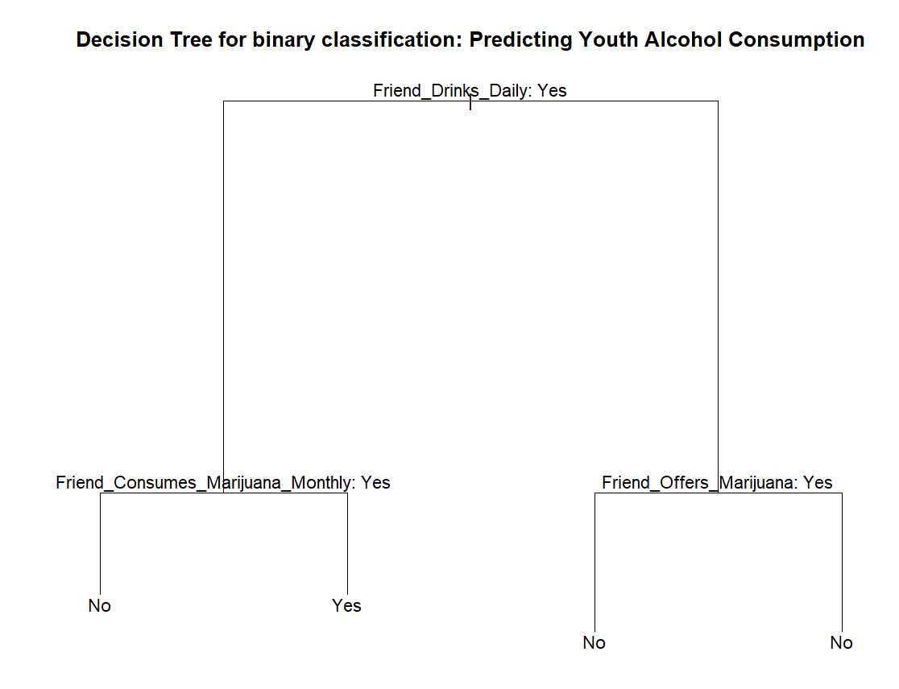
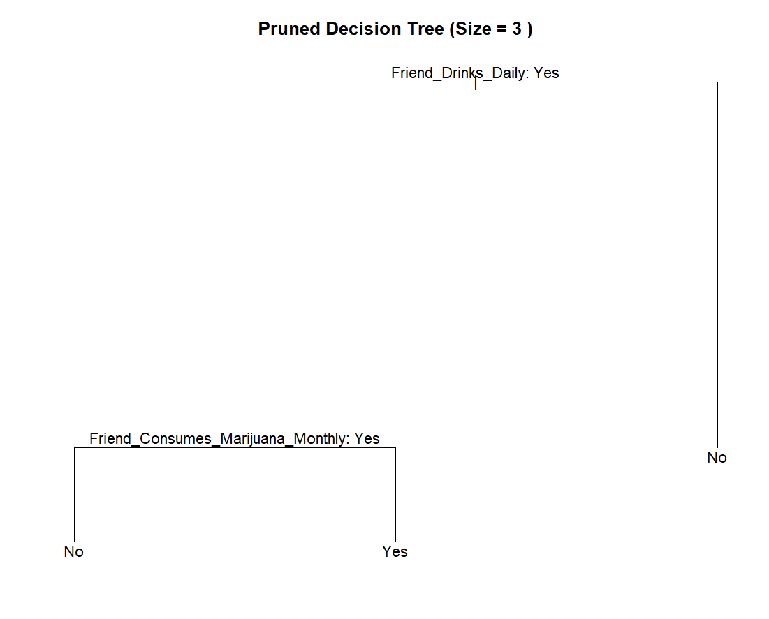
BINARY CLASSIFICATION: DECISION TREE BEFORE VS AFTER PRUNING

Slide 15
FLOW OF THE TREE FOR BINARY CLASSIFICATION MODEL(PRUNED)
The model begins by assessing whether a youth’s friends drink daily. If they do not, it predicts no alcohol consumption.
If daily drinking by friends is confirmed, it then evaluates their monthly marijuana use. If they use marijuana monthly, it again predicts no alcohol consumption.
Only when friends drink daily and do not use marijuana monthly does the model predict that the youth has consumed alcohol.
This Decision Tree emphasizes the central role of peer drinking behavior while reducing model complexity.

Slide 16
FLOW OF THE node FOR BINARY CLASSIFICATION MODEL
The model first checks whether a youth’s friends drink every day.
If none do, it predicts the youth has never tried alcohol.
When daily drinking is confirmed, it then evaluates those same friend’s monthly marijuana use.
If they use marijuana at least once a month, the model still predicts no alcohol consumption.
Only when friends drink daily and do not use marijuana monthly does the model predict that the youth has consumed alcohol.

Slide 17
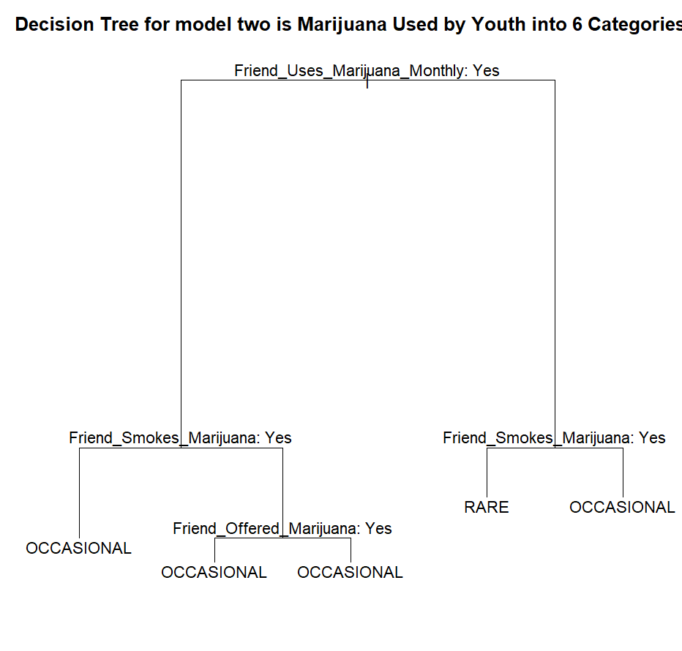
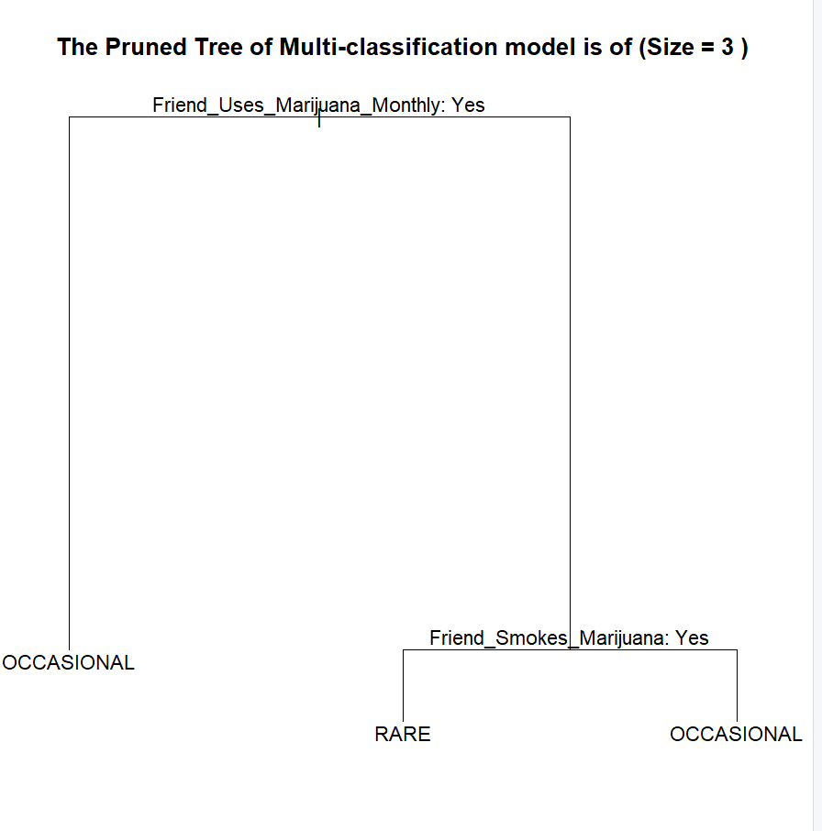
MULTI-CLASS CLASSIFICATION: DECISION TREE BEFORE VS AFTER PRUNING
Both before and after pruning the tree, only the Rare and Occasional levels were produced from the six possible usage categories.

Slide 18
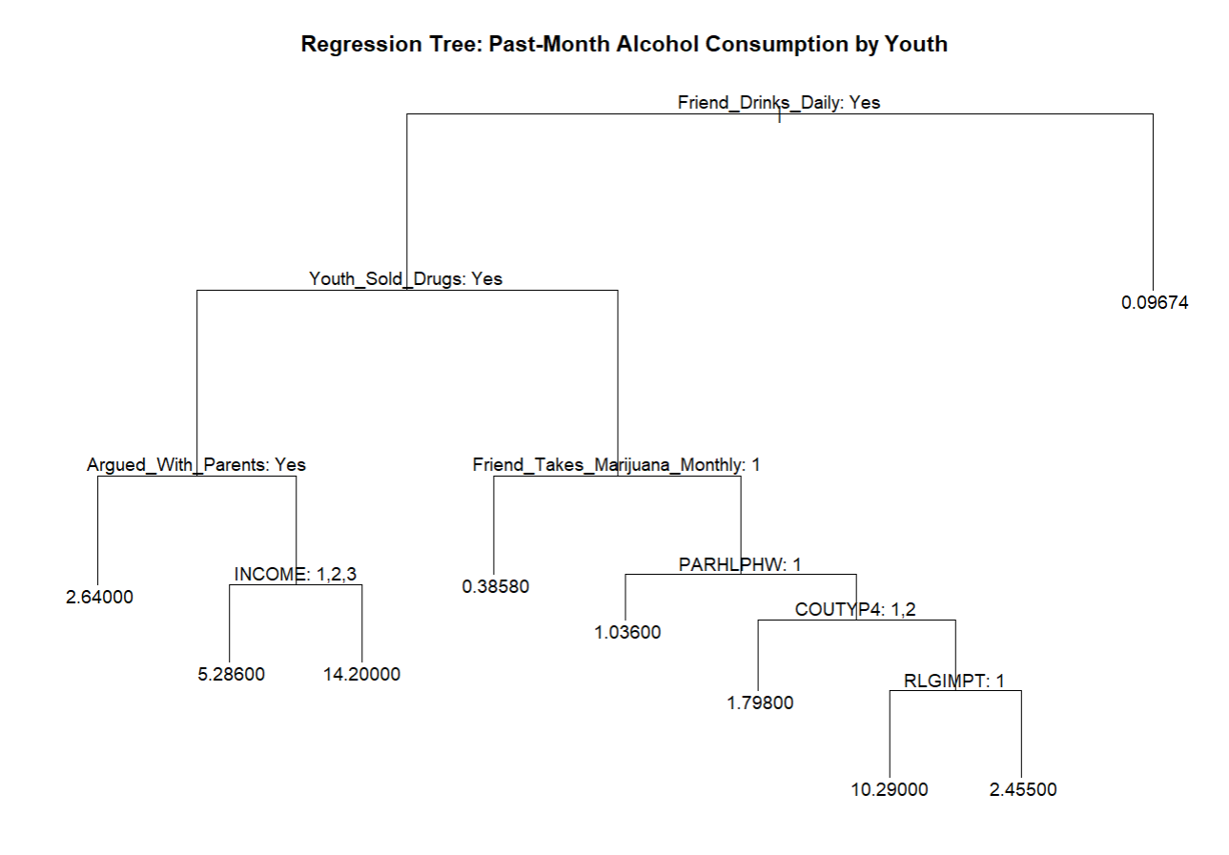
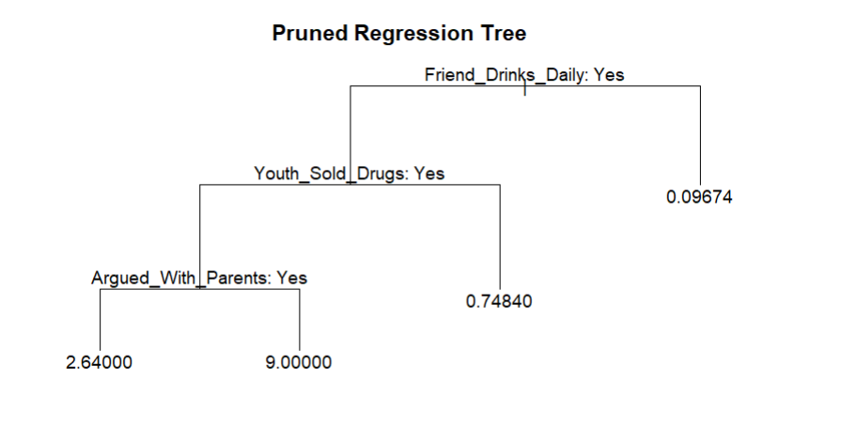
REGRESSION: DECISION TREE BEFORE VS AFTER PRUNING

Slide 19
DISCUSSION 1: Some of these variables are the same information coded into binary, ordinal (categorical and ordered), and numerical variables. How do the predictions change using each data type? What is each telling you, and when is it appropriate to use each?
Binary data converted each variable into yes or no, creating very clear splits but overlooking subtle differences. This was used when only the presence or absence of a trait mattered.
Ordinal ones maintained a level-based approach (for example, never, rare, occasional, and daily), allowing the model to find meaningful thresholds. This was applied when order mattered but exact quantities did not.
The numeric ones retained the original values, enabling the tree to identify precise cut-points and capture detailed trends. This was chosen when a continuous relationship was expected and overfitting could be controlled.

Slide 20
DISCUSSION 2: Which variables tend to be important for predicting drug use? How can these be interpreted? What are the implications of this outcome? How can you, as the data science communicator, discuss these findings in an ethical way?
For the binary classification model, friend’s daily drinking and monthly marijuana use best predicted whether a youth tried alcohol, suggesting prevention efforts target peer norms.
For the multi-class classification model, friend’s marijuana use, smoking habits, and offers of marijuana best predicted usage frequency, indicating value in reducing availability and peer pressure.
For the regression model, friends daily drinking, the youth’s involvement in selling drugs, and frequent family arguments explained drinking days per month, highlighting the need for social and family support.

Slide 21
DISCUSSION-2
As data science communicators, we should avoid labelling people based on these factors. Instead, it's best to acknowledge study limitations, and recommend further research for balanced interpretation.
The key limitations are reliance on self-reported survey data may introduce bias, and limited sample representativeness, as the NSDUH youth subset under 18 might not generalize across all regions or demographic groups.

Slide 22
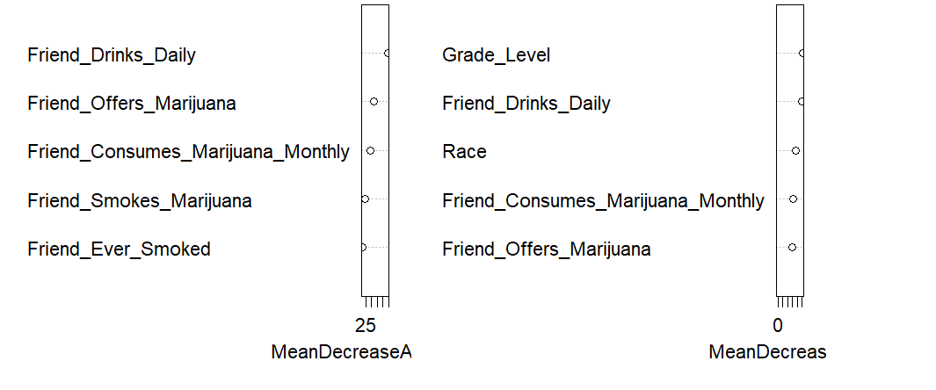
THE TOP FIVE MOST Important VARIABLES
BINARY CLASSIFICATION MODEL

Slide 23
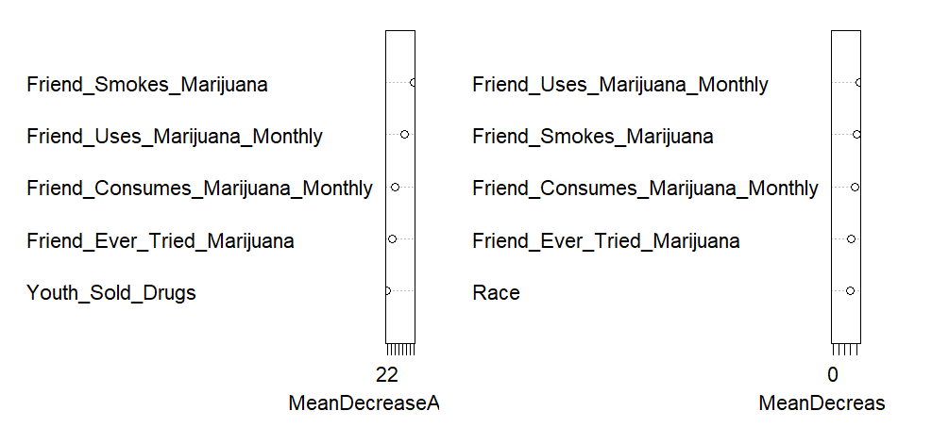
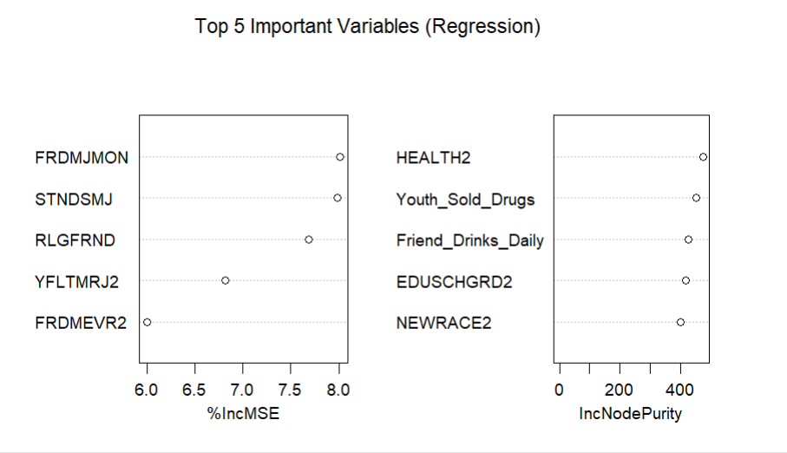
THE TOP FIVE MOST Important VARIABLES
MULTI-CLASS CLASSIFICATION MODEL
REGRESSION MODEL

Slide 24
conclusion
The study demonstrated that decision trees and ensemble methods are effective at predicting youth substance use.
Friends’ daily drinking and monthly marijuana use emerged as the most influential factors in youth substance use.
Prevention strategies should focus on modifying peer group norms and clearly communicate that these findings represent associations, not causation.

Slide 25
BIBLIOGRAPHY
[1] Image from Slide 4: What is a Decision Tree? | IBM
[2] Image from Slide 5: Pruning (decision trees)
[3] Image from Slide 6 and 8: Ensemble: Bagging, Random Forest, Boosting and Stacking
[4] Class presentation slides and worksheets. Data 5322 Coursework, Seattle University, 2025.

Slide 26
THANK YOU!!!

